Slide 1

E-commerce Company Path to Sustainable Growth
Operational Analysis and Optimization
PROJECT BY – RAVI KUMAR

Slide 2


Company Background
An e-commerce company is experiencing various operational challenges that hinder its sustainable growth and customer satisfaction.
To address these challenges, the company has decided to take a data-driven approach to optimize its key areas of operation.

Slide 3

Key Challenges
Improve financial performance
Enhance customer insights
Streamline logistics
Optimize product management
Improve customer satisfaction and return rates

Slide 4

outcome
By conducting this comprehensive analysis, the company aims to make informed decisions, streamline operations, and implement strategies that will lead to increased revenue, better customer satisfaction, and a competitive edge in the retail landscape.

Slide 5

Stakeholders
Company Leadership
Finance Team
Marketing Team
Logistics and Fulfillment Team
Product Management Team
Customer Support Team
IT/Data Analytics Team
Customers (B2B and B2C)
Suppliers and Vendors
Third-Party Fulfillment Partners (e.g., Amazon)
Warehouse/Inventory Management
Customer Feedback and Quality Assurance Teams

Slide 6

Technical Processes
By using Python Library
Pandas : Data cleaning , Duplicate remove , Replace null values and
Data analytics
Matplotlib : Visualization , Graphs , Interactive charts
Power BI : Dashboard , Data Visualization , Insights

Slide 7
KEY PERFORMANCE INDICATOR (KPI)
Total Order Id 128943
Total Quantity Sold 116648
Total Revenue 71772314
Average Order Value 596.35

Slide 8
Important Problems
Identify the top 5 selling products category by Revenue ?
Identify the top 5 locations by customers purchase rate is high?
Find the trend of the sales data by Revenue for analysis purpose ?
Evaluating the percentage of orders fulfilled by Amazon versus
Merchant will provide insights ?
Identify the peak sales days to contribute more efficient resource
management?
Find the average quantity ordered per product category to analyze t
the inventory management better ?

Slide 9
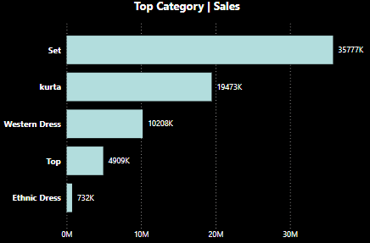
1. Identify the top 5 selling products category by Revenue ?

Slide 10
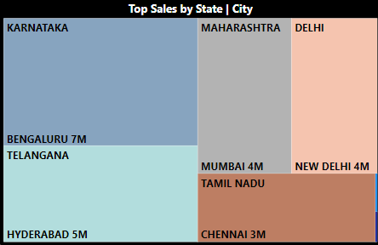
2. Identify the top 5 locations by customers purchaes rate is high?

Slide 11
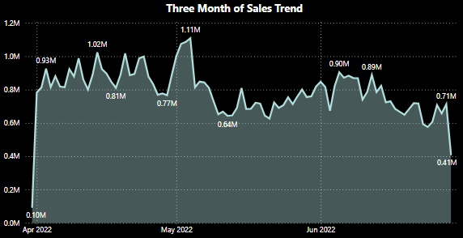
3. Find the trend of the sales data by Revenue for analysis purpose ?

Slide 12
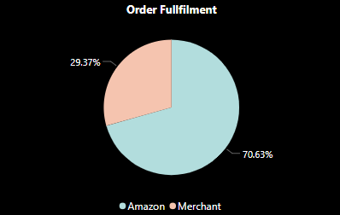
4. Evaluating the percentage of orders fulfilled by Amazon versus Merchant will provide insights ?

Slide 13
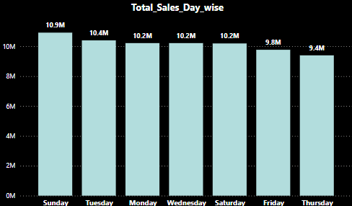
5. Identify the peak sales days to contribute more efficient resource management?

Slide 14
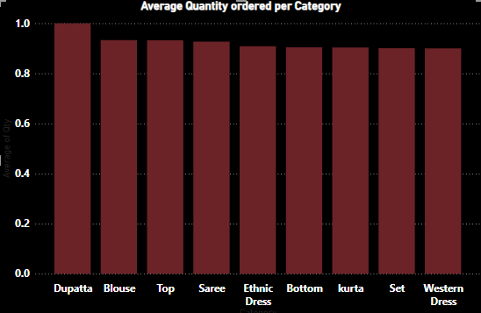
6. Find the average quantity ordered per product category to analyze the inventory management better ?

Slide 15
Conclusion
Total Revenue: The total revenue generated during the analyzed period is ₹71,772,313.62 .suggesting seasonal growth likely due to sales events or holidays.
Top-Selling Product Categories: The Set category led the sales, contributing to a significant portion of the total revenue. It was followed by Kurta and Western Dress categories, which also performed well.
Average Order Value (AOV): The average order value is calculated to be ₹596.3 , indicating the typical spending pattern of customers per order.
Fulfillment Methods: Orders fulfilled by Amazon generated higher revenue compared to those fulfilled by Merchants. Amazon’s fulfillment accounted for 69.5% of total Orders, highlighting its efficiency in managing orders. Refer the pie chart for better understanding.

Slide 16
Conclusion
Peak Sales Days : The Day of Sunday saw the highest sales volume, while Tuesday and Wednesday also showed strong performance. Thursday had significantly lower sales . Refer the Column chart for better understanding.
Return and Cancellation Rates: The overall cancellation rate stands at approximately 16% , affecting the company’s profitability. A deeper analysis indicates that Set and Kurta items had the highest return and cancellation rates .
Top Cities for Sales: , Bangalore, Hyderabad and Mumbai were the top-performing cities in terms of sales, collectively contributing to total revenue. These cities were key markets for the company’s growth.
B2B vs B2C Sales: B2C customers exhibited higher average order values, with bulk orders for Kurta and Set items. B2B customers were more price-sensitive, reflected in smaller, more frequent orders. These conclusions provide actionable insights for improving logistics, customer satisfaction, and overall revenue growth(Problem Statement).

Slide 17
recommendations
Address High return rates, especially in clothing, by improving product descriptions with detailed sizing guides and introducing size recommendation tools or virtual fitting rooms.
Capitalize on peak sales periods, By planning targeted marketing campaigns and offering discounts during off-peak months to balance revenue across the year.
Implement loyalty programs, personalized offers, and smaller bundle packages to increase average order value and customer retention in the B2C segment.
Invest in localized marketing and improved delivery options (e.g., same-day delivery) in top cities like Mumbai, Bangalore, and Chennai to enhance the customer experience.
Reduce order cancellations by introducing real-time stock tracking and sending timely notifications to customers about delayed or out-of-stock items.
Regularly collect and analyze customer feedback to address pain points related to returns, cancellations, and overall satisfaction, leading to improved retention.

Slide 18




Thank You !
For any suggestion feel free to ask any Question
ravisingh152458@gmail.com
Linkedin
Dashboard
RAVI KUMAR

